Slide 1
Optiver – 07
Meeting minutes &
Action point slides
Date: 13/04/2025 (Week 7)
Present: Ayush Singh, Christy Lee, Kylie Haryono, Zichun Han, Tobit Louis.

Slide 2
Feature Engineering
We created a pipeline using scikit-learn for feature engineering.
The pipeline takes in the raw dataset and creates 40 New features which will give additional signals to our Machine Learning models about the dataset.
We also plotted the correlation heatmap of the newly created features to get additional information about them.

Slide 3
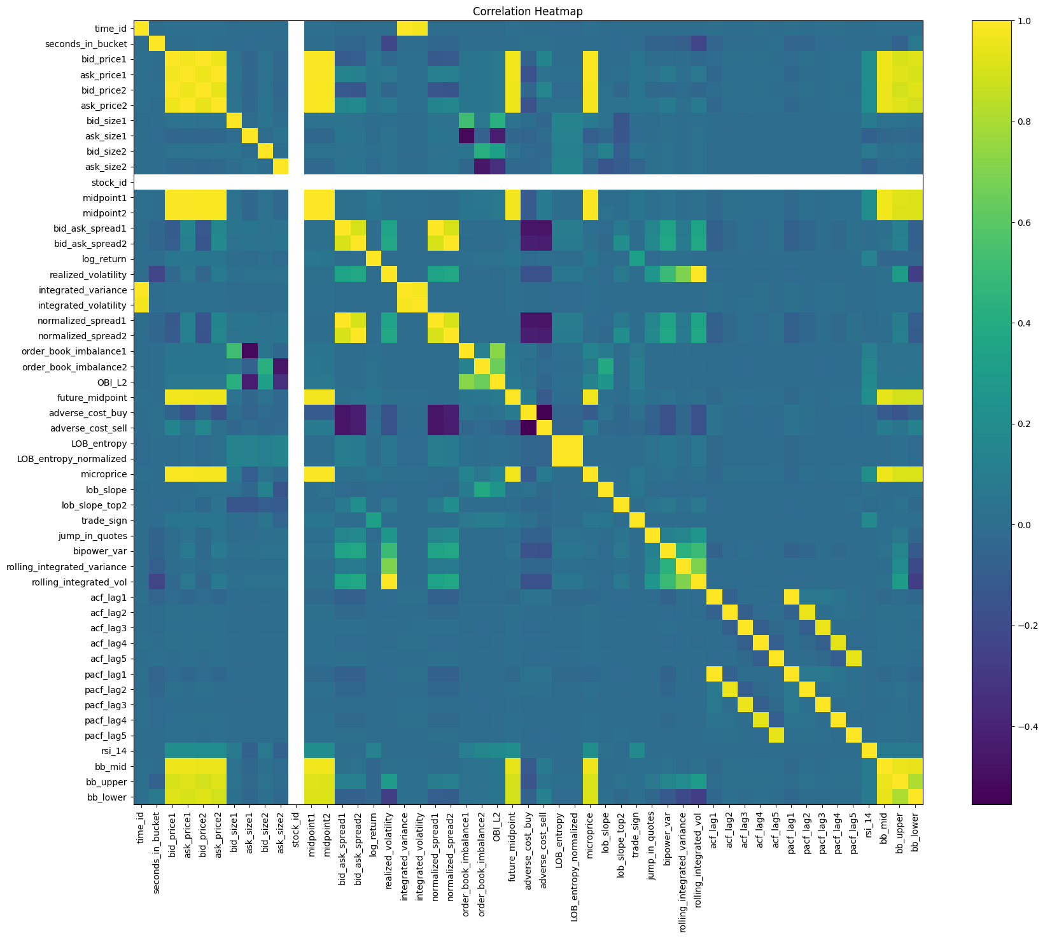

Slide 4
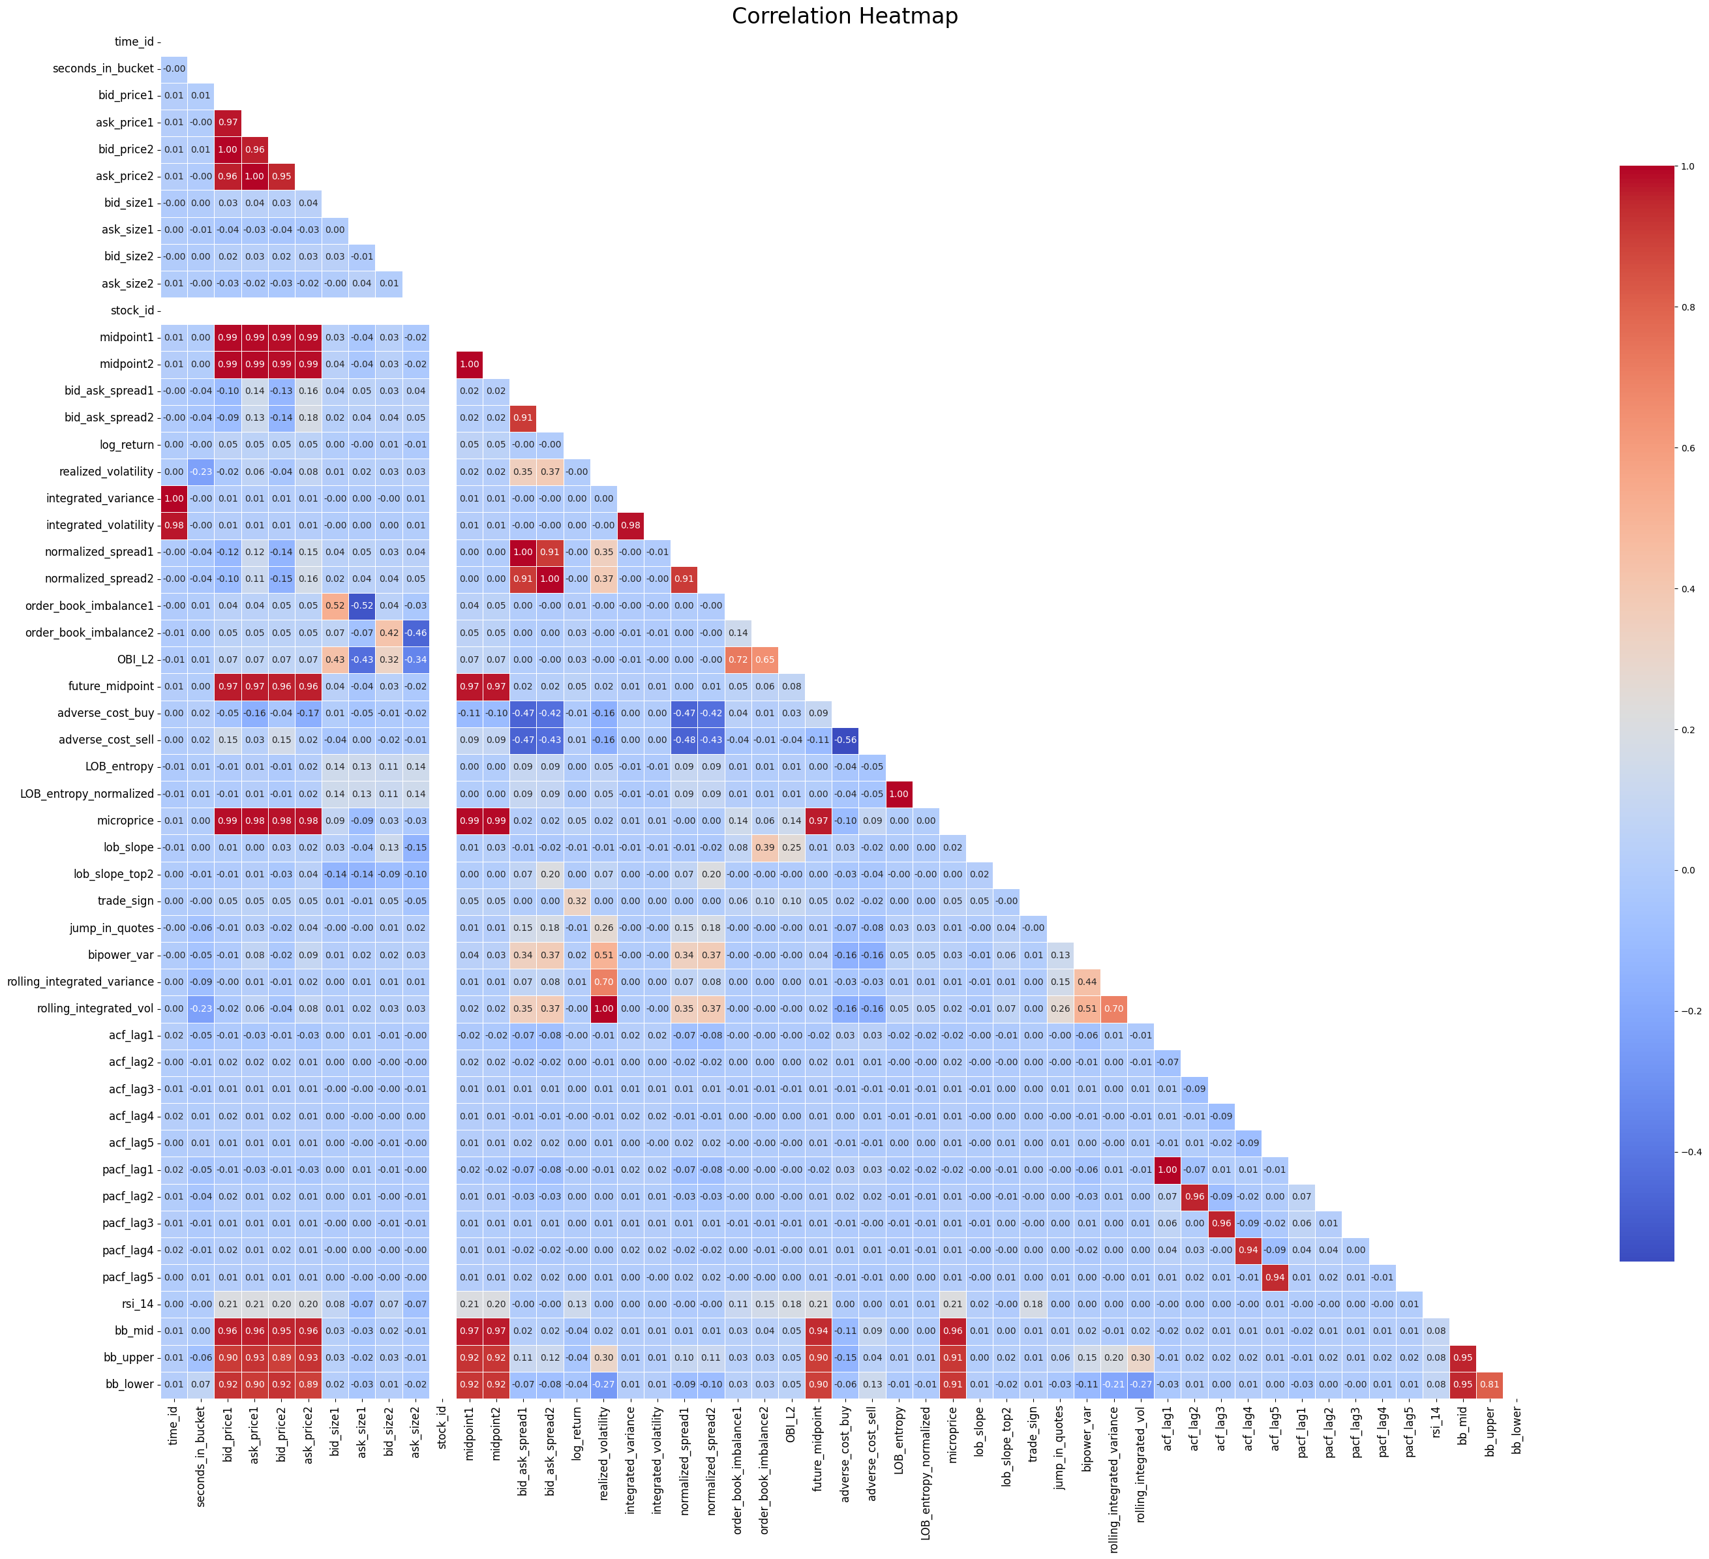

Slide 5
Exploratory Data Analysis
We plotted histograms of all the 50 columns and compared them to understand the data distribution in each of them.
We also plotted two grid-search plots comparing different window sizes for the realized volatility column.
Finally, we plotted some scatter plots and did some PCA Analysis to understand the each feature’s dependence on realized volatility.

Slide 6
Model Testing
On the data set with new features we tested several machine learning models to understand the complexity and the time constraint of each model along with it’s accuracy.
We used Autoencoder-MLP, CNNs the Gramian Angular Fields, LSTM-GARCH, SHL and MHL Neural Networks, and a Ridge Regression this week.
We compared the models accuracy and possible overfitting cases through plots.

Slide 7
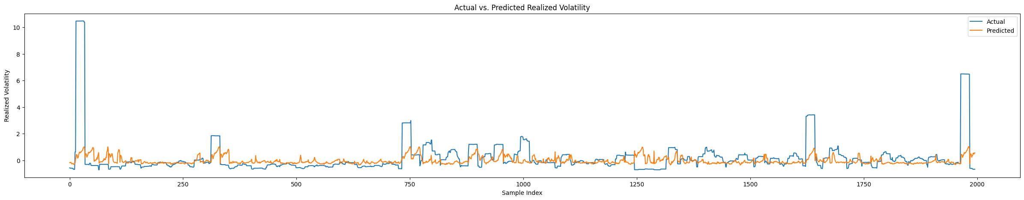
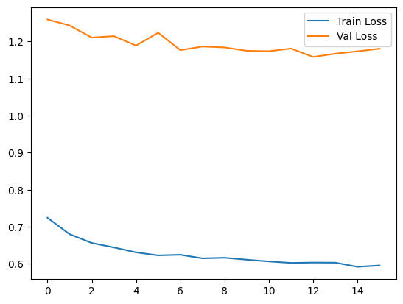

Slide 8
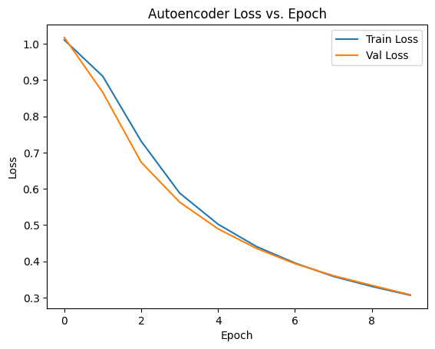
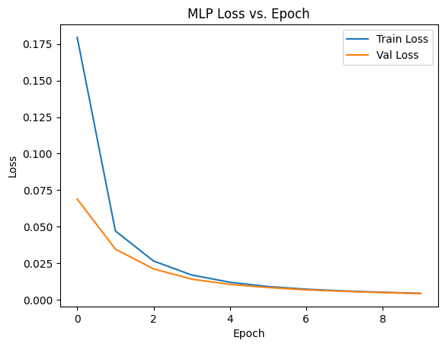

Slide 9
Next Steps– Week 08
This week we will compare a lot of different models to see which one to use for our final ensemble.
We will test model efficiency on subsets of the entire datasets.
We will figure out a way to use the ensemble on the entire dataset.
We will also review the work we have done so far and start making our presentation till current progress.

